Slide 1
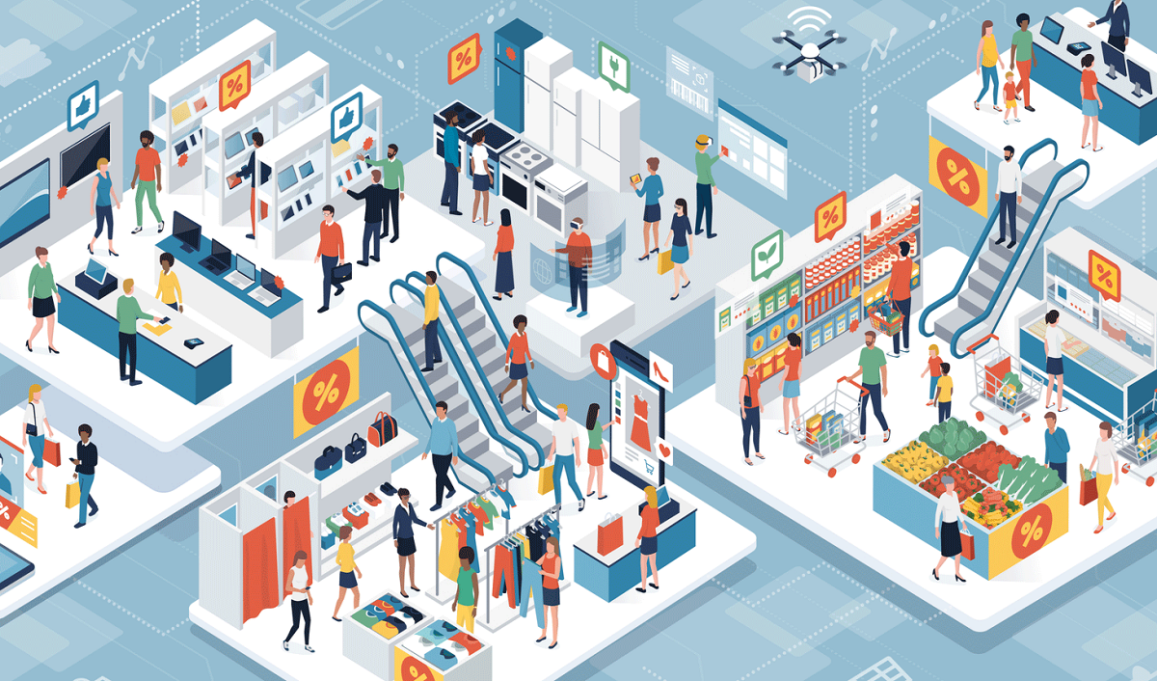

Slide 2

Factors Driving the Growth of Indian Retail Market
Burgeoning Millennial Population and Changing Outlook towards Spending
Increasing Women Workforce
Growing Wallet Share and Price Trade-Off
Growth of Markets
Growth of Malls

Slide 3

Trends In Indian Retail Market
Rise of New Channels
Merging of Offline and Online Boundaries
Modernisation of Supply Chain
Shift in User Mindset to ‘Safe Commerce’

Slide 4
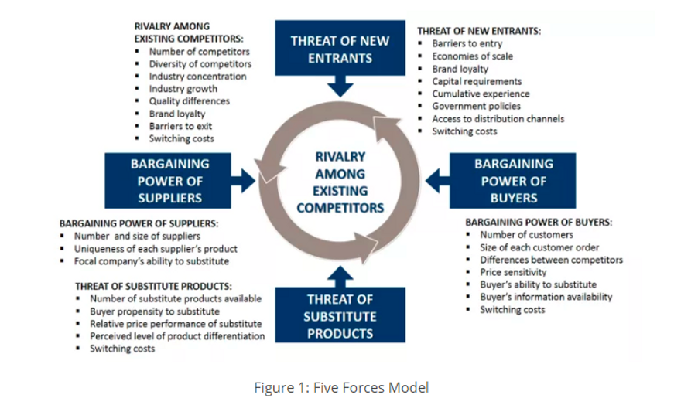
Five Forces Model

Slide 5


Slide 6
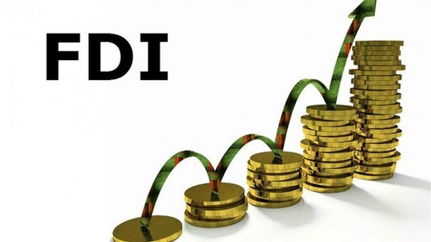
Foreign direct investment (FDI) occurs when a firm invests directly in new facilities to produce and/or market in a foreign country
Once a firm undertakes FDI it becomes a multinational enterprise
In 1997, FDI cash and carry (wholesale) with 100% rights was allowed with government approval.

Slide 7
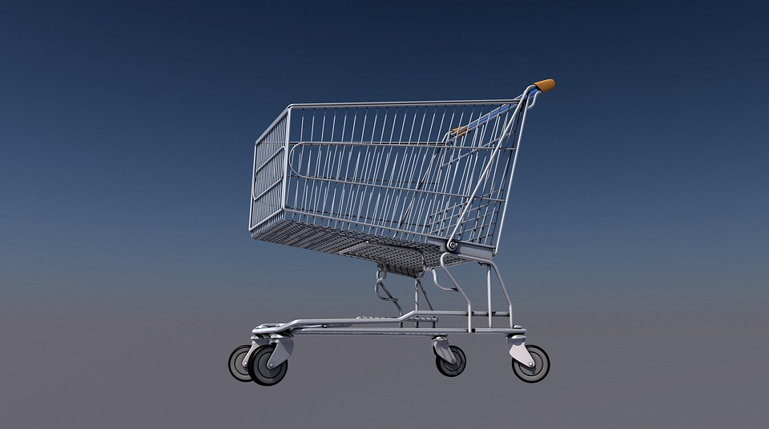
Forms of FDI
A greenfield investment (the establishment of a wholly new operation in a foreign country)
Acquisition or merging with an existing firm in the foreign country

Slide 8

FDI Trends in Indian Retail Sector
Growth and Development of Farmers
Generating New Employment
Benefits to Consumers Entry of foreign retailers
Capital Inflow FDI in retail trade
Infrastructure Development India

Slide 9
Cont..,
Development of SSIs FDI
FDI reduce inflationary pressure
Inflow of Technical Know-how
Improved Supply Chain Management
Cost Reduction
Growth of GDP

Slide 10

Challenges
Benefits only those farmers who collaborate with multinationals
Opening the doors to big entities - endanger the livelihoods of small traders
Multinational corporations capturing the retail space in the country

